Slide 1


RAMCO INSTITUTE OF TECHNOLOGY
RAJAPALAYAM
Dept. of Artificial Intelligence and Data Science
AI POWERED ORAL CANCER SCREENING SYSTEM
AD3811 - Project works
Final Review
Presented By
Sandeep kumar M (953621243047)
Project Supervisor
Dr.R.M.Rajeswari
Associate Professor
Artificial Intelligence and Data Science

Slide 2
Abstract
This project presents a deep learning–based approach for the early detection of oral cancer using image classification. A lightweight convolutional neural network, MobileNetV3, is fine-tuned to categorize oral cavity images into three diagnostic classes: Healthy, Benign, and Oral Potentially Malignant Disorders (OPMD). A curated dataset of 2,190 images was preprocessed using data augmentation and normalized to ensure class balance and consistency. The model was trained using a weighted cross-entropy loss function and achieved promising results with high training and validation accuracy. The entire solution is integrated into a web interface that allows users to upload images, receive real-time predictions, and download diagnostic reports, making it a scalable and deployable healthcare tool.

Slide 3
Problem Statement
Oral cancer is a major global health concern, especially in regions with high tobacco and alcohol use.
Early detection is crucial but often delayed due to:
- Lack of awareness,
- Limited access to specialists,
- Time-consuming and subjective diagnostic methods.
Traditional examination methods are not always feasible in rural or low-resource settings.
There is a need for an automated, fast, and reliable diagnostic tool to assist in early screening.

Slide 4
Objectives
Develop an AI-based system for classifying oral cavity images into clinically relevant categories.
Build and balance a dataset of 2,190 oral images using public sources and augmentation techniques.
Implement MobileNetV3, a lightweight and efficient CNN architecture, optimized for medical image classification.
Train and evaluate the model using metrics such as accuracy, precision, recall, and F1-score.
Deploy the trained model in a web-based application for real-time inference and report generation.
Contribute to the development of accessible, early-stage oral cancer screening tools for remote or low-resource settings.

Slide 5
Literature Review
Paper Title | Authors | Summary | Limitations
Multimodal Deep Convolutional Neural Network Pipeline for AI-Assisted Early Detection of Oral Cancer | Meenakshi K., Sugan S. (2023) | Combined oral images and metadata using MobileNetV3-Large and U-Net for segmentation. Achieved 81% accuracy with weighted loss and early fusion. | Requires patient metadata; image-only prediction not possible.
Searching for MobileNetV3 | Howard A., Sandler M., et al. (2019) | Introduced MobileNetV3 with neural architecture search for efficient mobile inference; lightweight and accurate CNN for low-latency tasks. | Not trained for medical images; needs fine-tuning for medical applications.
Deep Learning-Based Oral Cancer Classification Using Histopathological Images | Amin J. et al. (2021) | Used ResNet and EfficientNet with transfer learning to classify histopathology patches for OSCC. Achieved accuracy > 90%. | Invasive input method (biopsy); not usable for real-time, non-invasive screening.

Slide 6
Paper Title | Authors | Summary | Limitations
Attention Residual Learning for Skin Lesion Classification | Zhang J., Xie Y., Xia Y. (2019) | Introduced an attention mechanism within residual networks to focus on lesion regions, improving classification accuracy in skin lesion tasks. | Tested on skin lesions, not validated on oral cancer data.
Low-Cost Smartphone-Based Fluorescence Imaging with Deep Learning for Oral Cancer Screening | Uthoff R. et al. (2018) | Developed a mobile fluorescence device integrated with CNN for oral lesion detection. Achieved 80%+ sensitivity and specificity. | Requires custom hardware; cannot be used with standard RGB images.
Histopathological Image Classification Using Confocal Endomicroscopy | Aubreville M. et al. (2017) | Used LeNet-5 on endomicroscopy images for OSCC classification. Demonstrated improved results over conventional feature-based methods. | Specialized imaging equipment needed; not scalable to community-level screening systems.

Slide 7
Proposed Methodology
Dataset Collection
Gathered 2,190 images from public datasets, categorized into:
Healthy
Benign
OPMD (Oral Potentially Malignant Disorders)
Each class has 730 images, ensuring class balance.

Slide 8
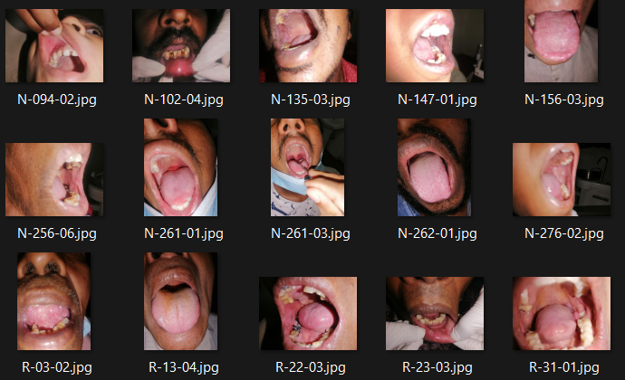
Sample Data

Slide 9
2. Data Preprocessing
Resizing images to 224×224 pixels
Normalization using ImageNet mean and standard deviation Real-time data augmentation:
- Random flips, rotations, color jitter, and scaling
Dataset split into:
- 80% Training
- 10% Validation
- 10% Testing

Slide 10
3. Model Design – MobileNetV3
Used MobileNetV3 for its balance of speed and accuracy
Pre-trained on ImageNet and fine-tuned on oral images
Custom classifier layer for 3-class output
Employed weighted cross-entropy loss to handle minor imbalance

Slide 11
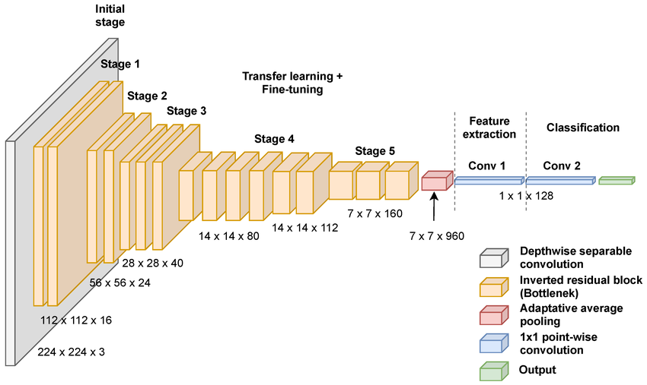
Feature Extraction of MobileNetV3

Slide 12
4. Model Training and Evaluation
Optimized with Adam optimizer (learning rate = 0.0003)
Trained over 10 epochs using GPU acceleration
Evaluated using:
- Accuracy, Precision, Recall, F1-score
- Confusion matrix analysis

Slide 13
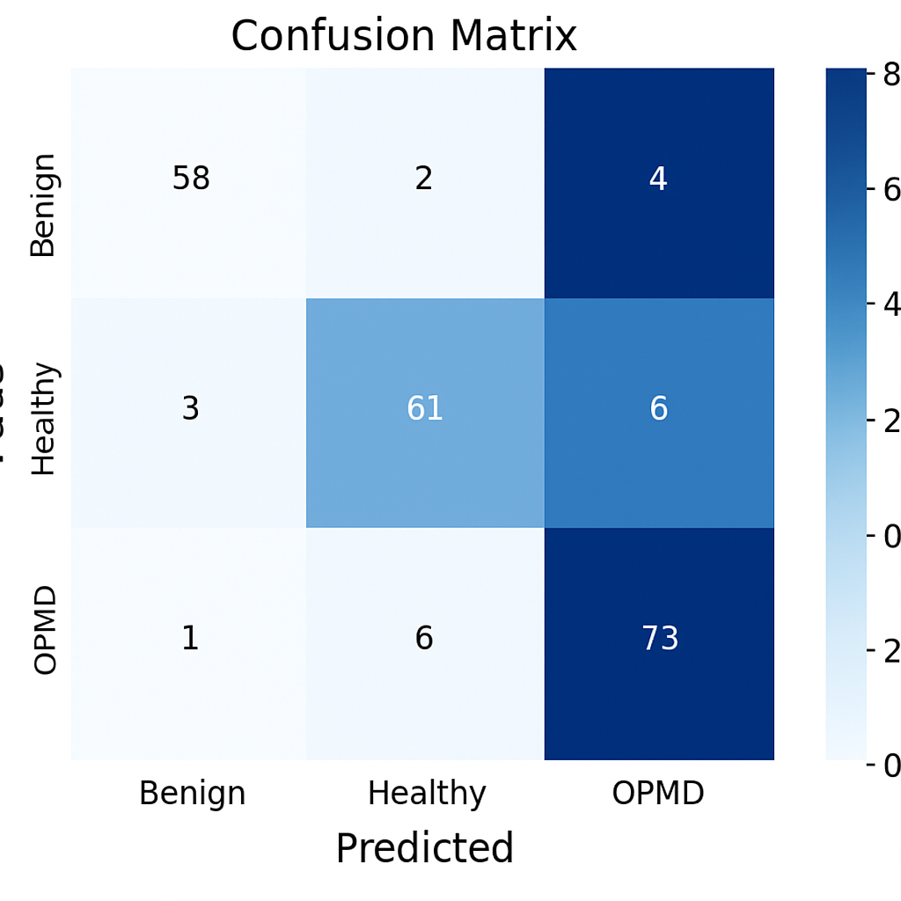
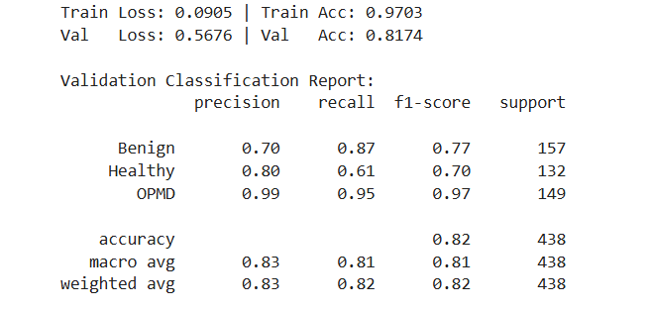
Evalution Metrics

Slide 14
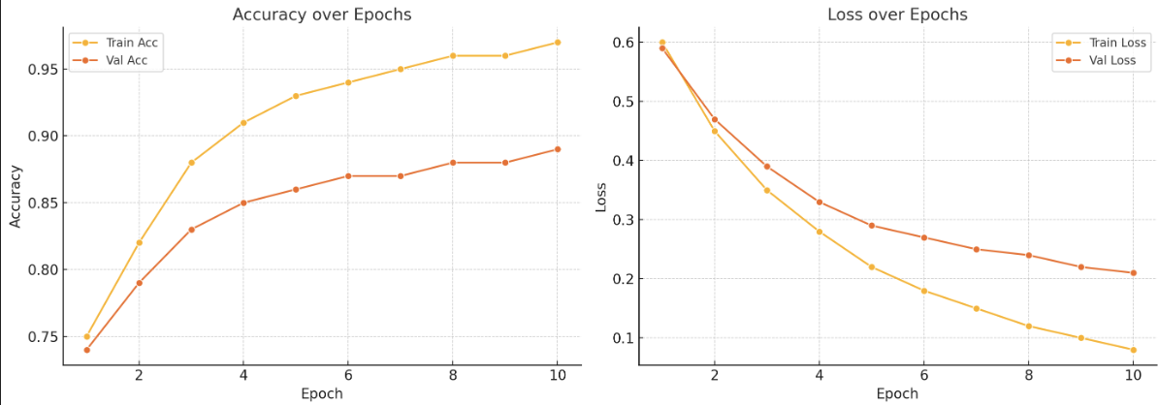
Train and Valid Track

Slide 15
5. Web Interface & Report Generation
Built using Flask for image upload and prediction
Generates a downloadable PDF report with:
- Prediction result
- Confidence score
- Uploaded image

Slide 16
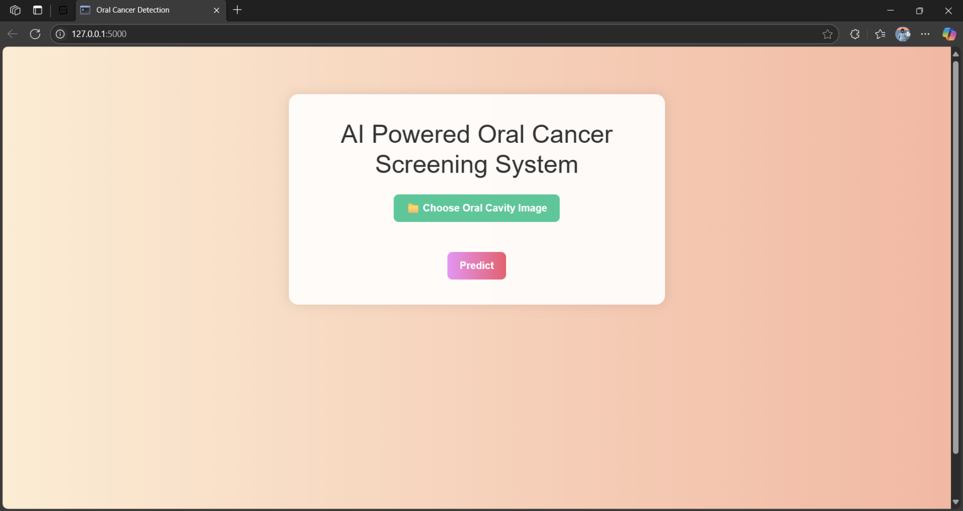
Project Outcome

Slide 17
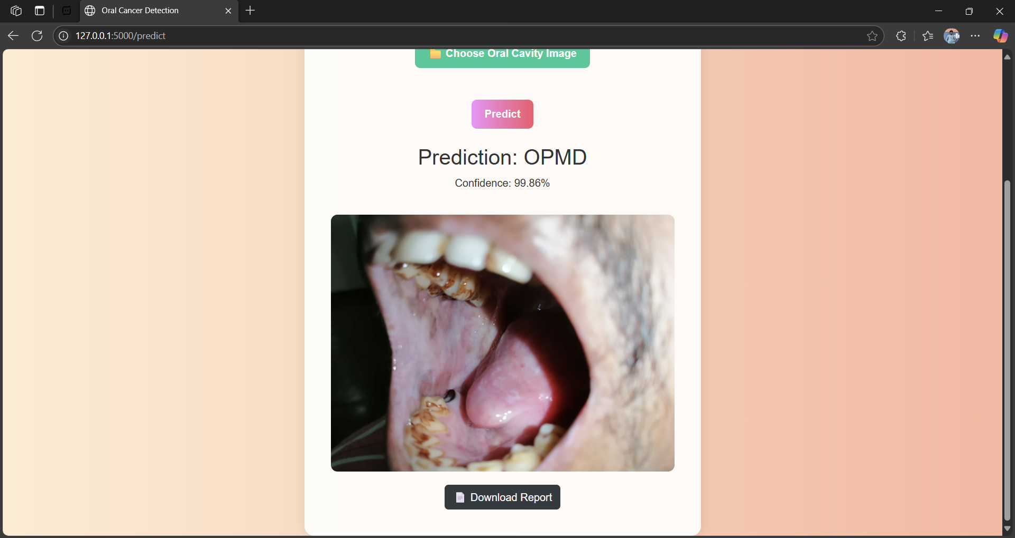

Slide 18
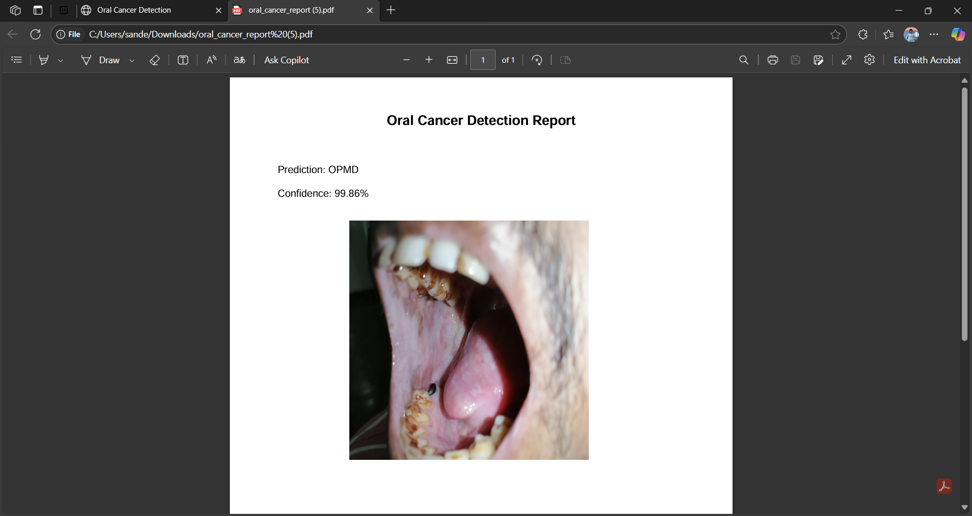

Slide 19
Conclusion
This project demonstrated an effective AI-based system for oral cancer
detection using the MobileNetV3 architecture. The model achieved high
accuracy across three diagnostic classes - Healthy, Benign, and OPMD
using a balanced dataset and data augmentation techniques.
A lightweight web interface was also developed, enabling real-time
predictions and PDF report generation. The system offers a scalable and
deployable solution for early screening, especially in resource-limited
settings.

Slide 20
References
Meenakshi, K., & Sugan, S. (2023). Multimodal Deep Convolutional Neural Network Pipeline for AI-Assisted Early Detection of Oral Cancer. Springer Nature.
Howard, A. et al. (2019). Searching for MobileNetV3. Proceedings of the IEEE/CVF ICCV.
Sandler, M. et al. (2018). MobileNetV2: Inverted Residuals and Linear Bottlenecks. CVPR.
Zhang, J., Xie, Y., & Xia, Y. (2019). Attention Residual Learning for Skin Lesion Classification. IEEE Transactions on Medical Imaging.
Paszke, A. et al. (2019). PyTorch: An Imperative Style, High-Performance Deep Learning Library. NeurIPS.
Deng, J. et al. (2009). ImageNet: A Large-Scale Hierarchical Image Database. CVPR.

Slide 21
Amin, J. et al. (2021). Transfer Learning for Histopathological Image Classification of OSCC.
Lin, Y. et al. (2021). Smartphone-Based Autofluorescence and RGB Imaging for Oral Cancer Detection.
S. P. Mohan, S. Jagannathan, and V. Rajendran, “Artificial intelligence in oral cancer diagnosis: Current status and future perspectives,” Oral Oncology, vol. 123, 105588, 2021. doi: 10.1016/j.oraloncology.2021.105588
A. C. Acharya, S. Bhattacharya, and S. Rajalakshmi, “Oral cancer detection using transfer learning and convolutional neural networks,” in Proc. Int. Conf. Smart Electronics and Communication (ICOSEC), 2020, pp. 1679–1683. doi: 10.1109/ICOSEC49089.2020.9215417

Slide 22
Thank You

